Slide 1
Computer Programming Basics
Jeon, Seokhee
Assistant Professor
Department of Computer Engineering,
Kyung Hee University, Korea

Slide 2
CHAPTER 7
Text I/O

Slide 3
Input and Output Entities
Input entities
  Keyboard, files
Output entities
  Monitor, files
Standard input
  keyboard
Standard output
  monitor

Slide 4
Files
Text files
  all the data are stored as characters
Binary files
  Data in the internal computer formats (Remember the “binary”)

Slide 5
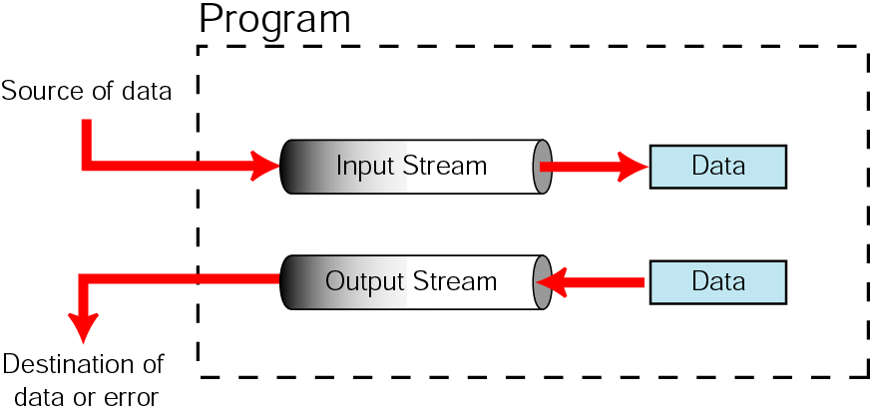
Streams
Creating → Connecting (source or destination) → Disconnecting.

Slide 6
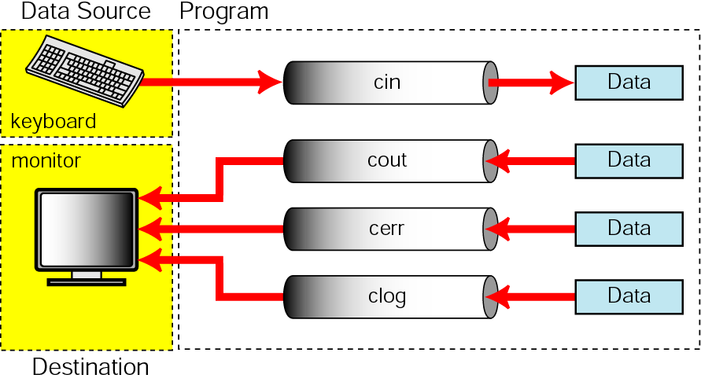
Standard Streams
Standard streams are created, connected, and disconnected automatically.

Slide 7
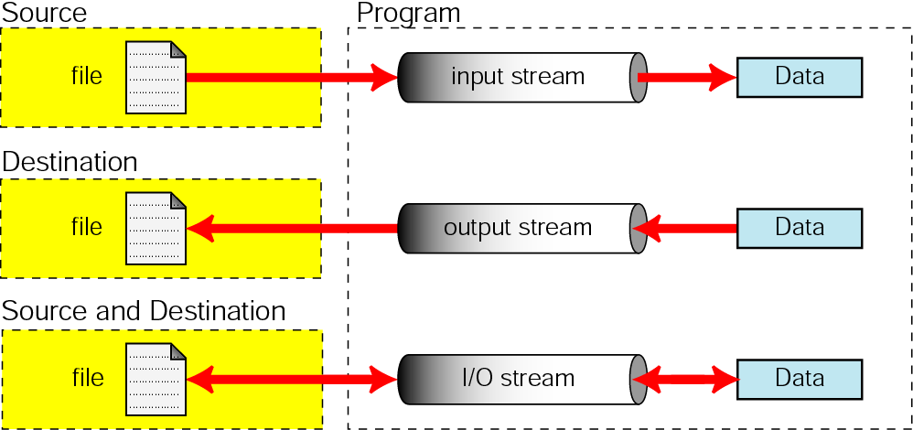
File Streams
File streams are created, connected to files, and disconnected from files by the programmer.

Slide 8
File Streams
ifstream (for reading from file)
ofstream (for writing to file)
fstream (read and write)
Creating file streams
  First define stream objects
    ifstream [stream variable name];
    ofstream [stream variable name];
    fstream [stream variable name];
  Connecting file streams
    Open ()
  Disconnecting file streams
    Close ()

Slide 9
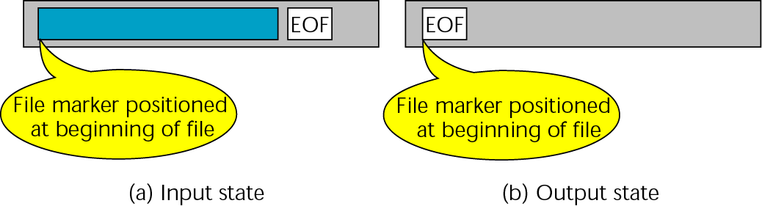
Standard Library Input/Output Functions (1)
File open
  ifstream fsInput;
  fsInput.open(“temp.txt”);
File close
  fsInput.close();

Slide 10
Standard Library Input/Output Functions (2)
  #include <fstream>
  …
  int main()
  {
  ifstream fsTemp;
  fsTemp.open(“temp.txt”);
  // process file
  fsTemp.close();
  return 0;
  }

Slide 11
Open and Close Errors
#include <iostream>
#include <fstream>
using namespace std;
int main() {
cout << "Start open/close error test\n";
ifstream fsDailyTemps;
fsDailyTemps.open ("ch7TEMPS.DAT");
if (!fsDailyTemps) {
cerr << "\aERROR 100 opening ch7TEMPS.DAT\n";
exit (100);
}
fsDailyTemps.close();
if (fsDailyTemps.fail()) {
cerr << "\aERROR 102 closing ch7TEMPS.DAT\n";
exit (102);
}
cout << "End open/close error test\n";
return 0;
}

Slide 12
Formatting Input and Output
Reading from file
  ifstream fsTemp;
  fsTemp.open (“temp.txt");
  fsTemp >> inTemp;
Writing to file
  ofstream fsTemp;
  fsTemp.open (“temp.txt");
  fsTemp << anyTemp;

Slide 13
Formatting Data (1)
Control variables
  width: determine how may display positions are to be used to display the data.
  fill: determines the nondata character that is to print when the print width is greater than the data width.
  precision: determines the number of digits to be displayed after the decimal point.

Slide 14
Formatting Data (2)
code 1/2
#include <iostream>
#include <cstdlib>
using namespace std;
int main() {
cout << "Test control variables\n";
cout << "Print with default settings\n";
cout << 'a' << 'B' << 'c' << endl;
cout << "Print with width 10\n"; cout.width (10);
cout << 'a' << 'B' << 'c' << endl;
cout << "\nTest fill character with * char\n";
cout.width(5); cout.fill ('*');
cout << 'a';
cout.width(5); cout << 'B';
cout.width(5); cout << 'c';
cout << "\nResetting default fill char\n";
cout.fill(' '); cout.width(5);
cout << 'a' << 'B' << 'c' << endl;

Slide 15
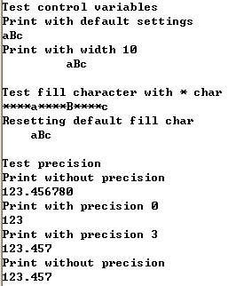
Formatting Data (3)
code 2/2
cout << "\nTest precision\n";
cout.setf (ios::fixed, ios::floatfield);
cout << "Print without precision\n";
cout << 123.45678 << endl;
cout << "Print with precision 0\n";
cout.precision(0);
cout << 123.45678 << endl;
cout << "Print with precision 3\n";
cout.precision(3);
cout << 123.45678 << endl;
cout << "Print without precision\n";
cout << 123.45678 << endl;
return 0;
}

Slide 16
Input/Output Stream Flags
Turning on or off input/output settings
Turning on
  stream.setf(ios::[flagname]);
Turning off
  Stream.unsetf(iso::[flagname])

Slide 17
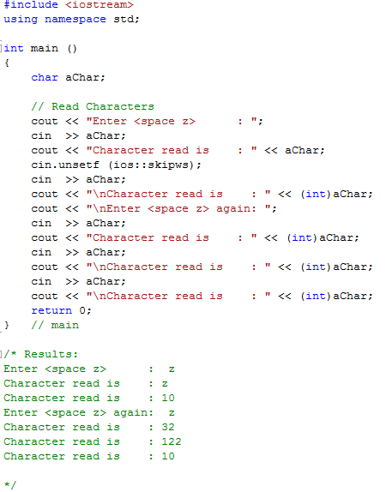
Stream Flag Examples: skipws

Slide 18
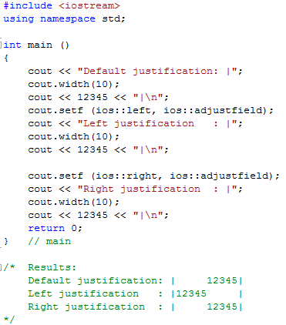
Stream Flag Examples: adjustfield, left, right

Slide 19
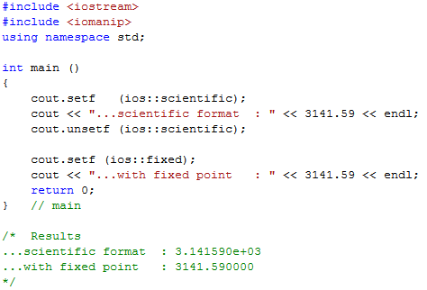
Stream Flag Examples: scientific

Slide 20
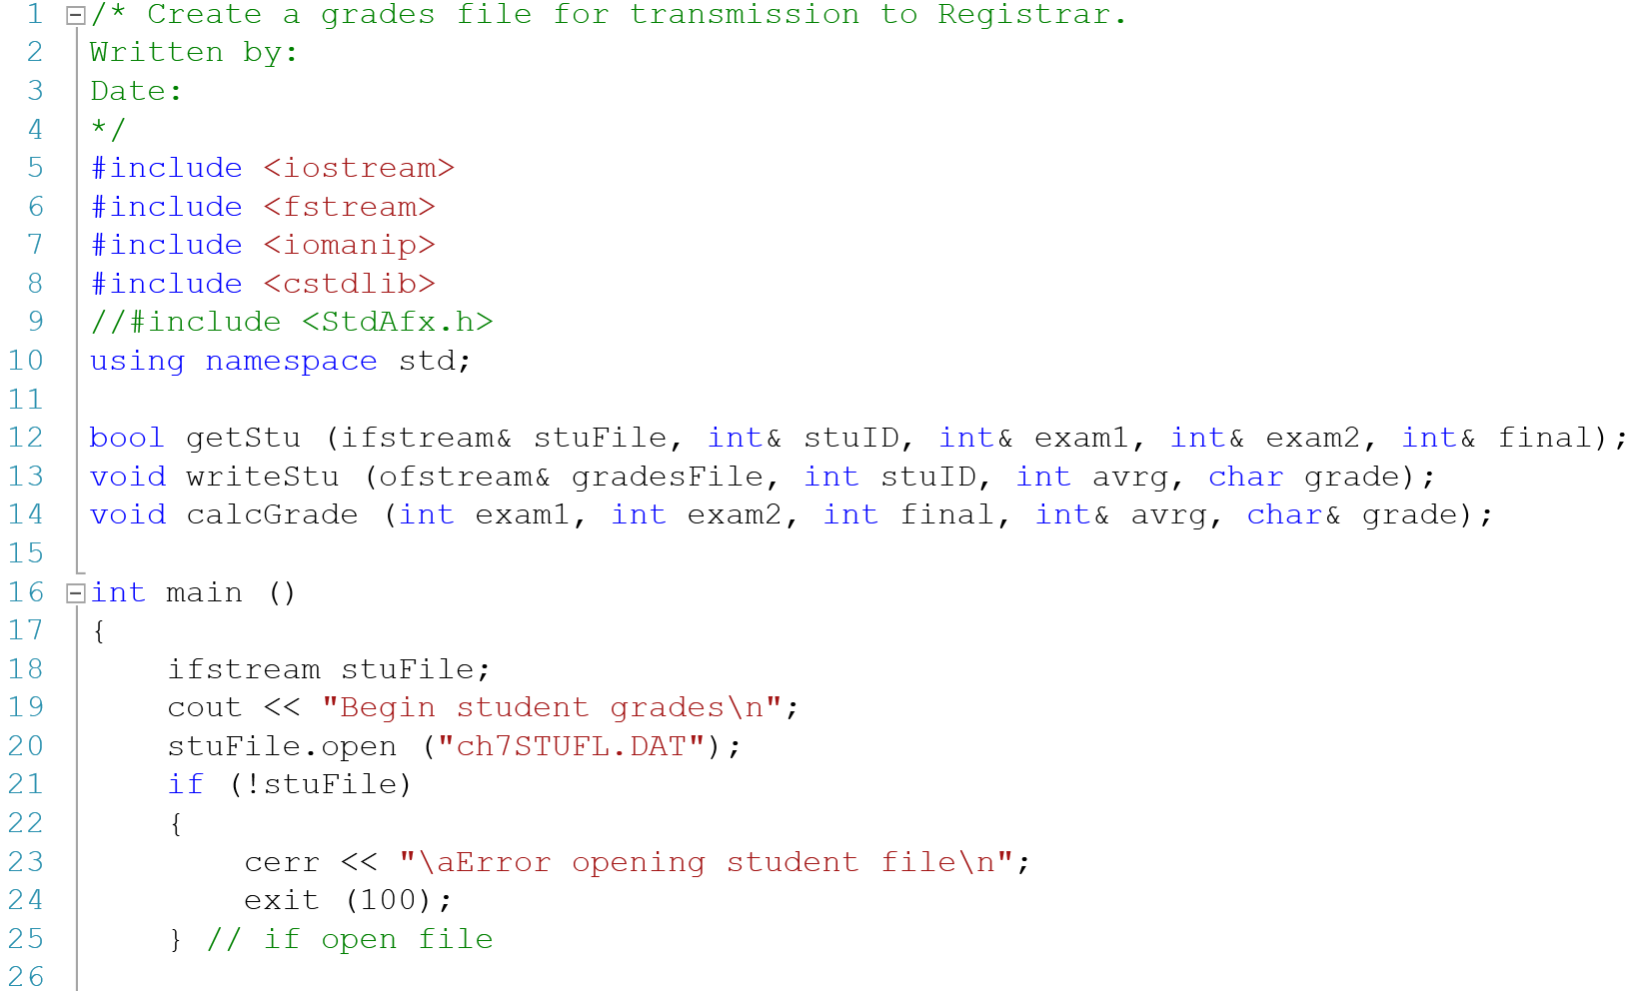
Student Grade Example

Slide 21
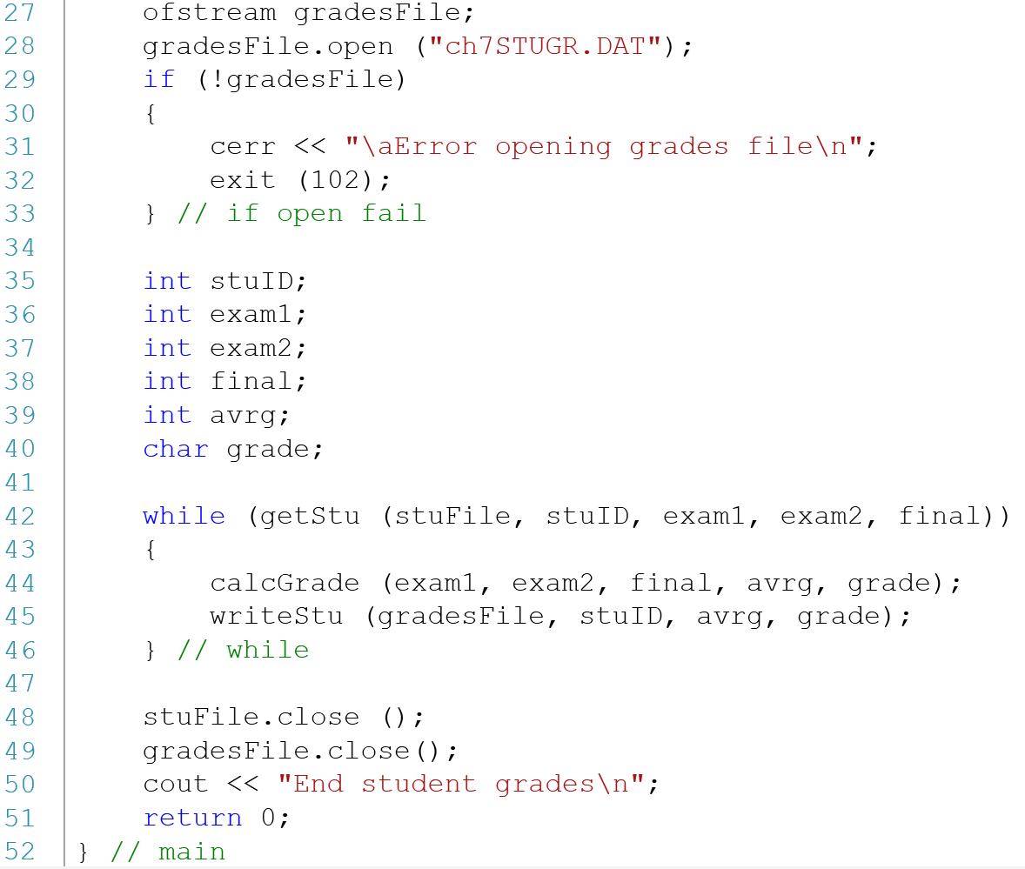
Student Grade Example

Slide 22
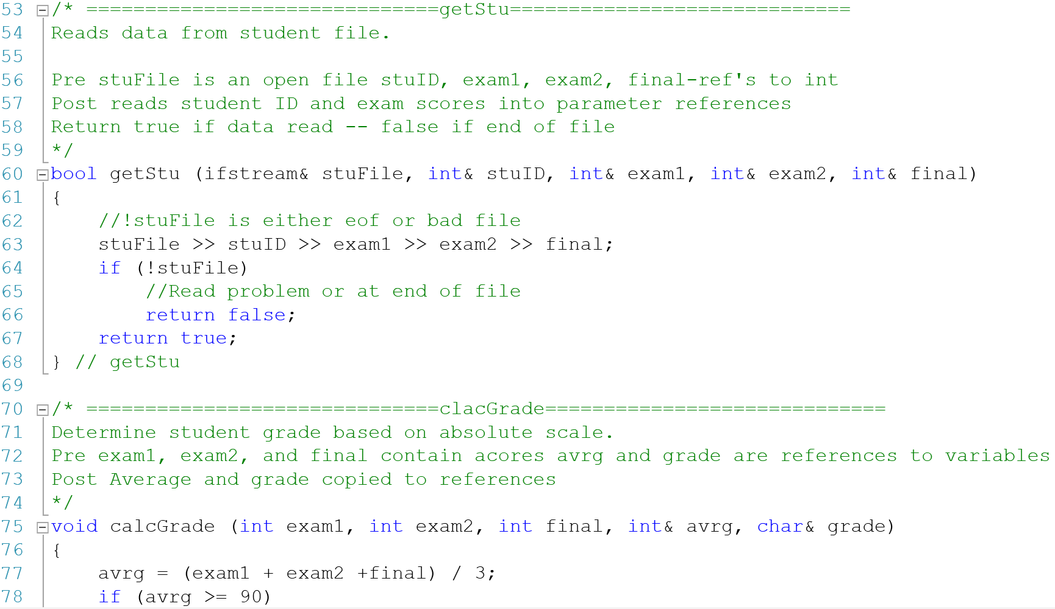
Student Grade Example

Slide 23
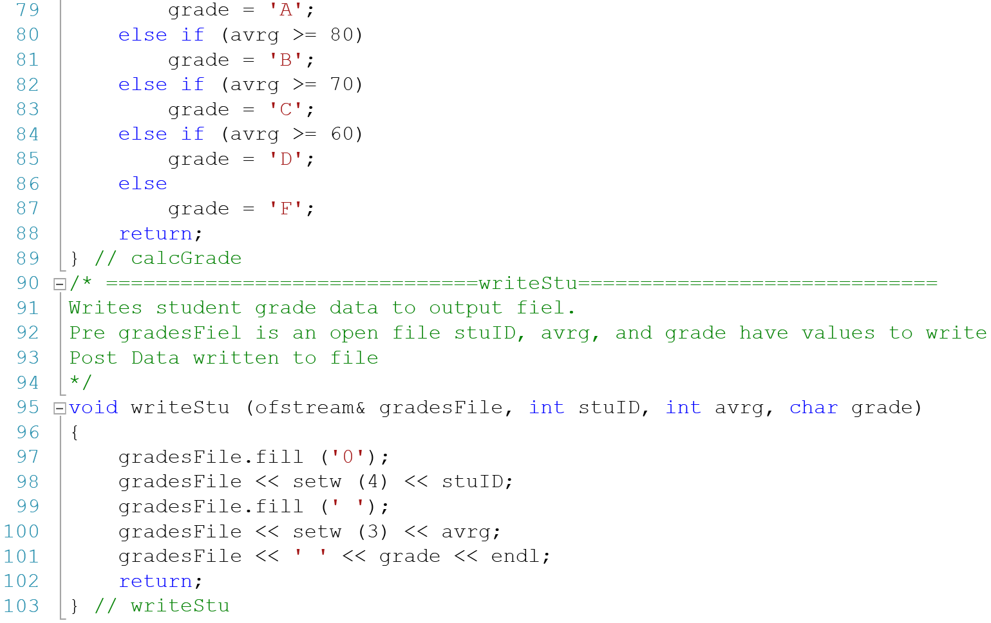
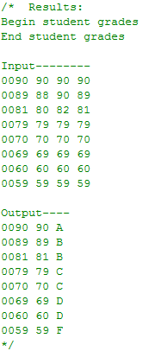
Student Grade Example

Slide 24
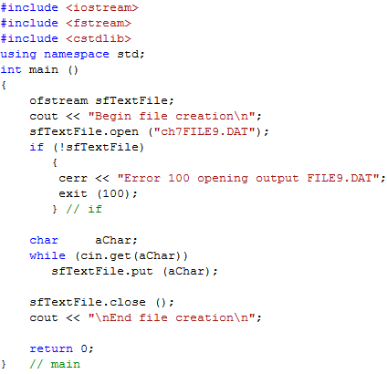
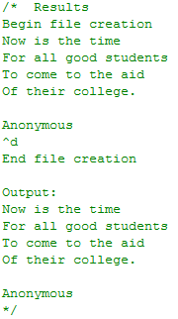
Creating Text File

Slide 25
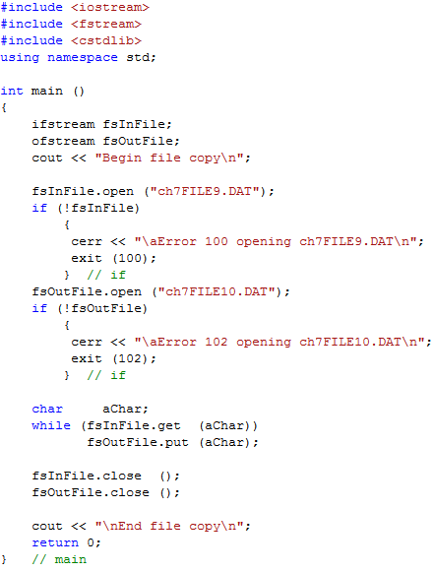
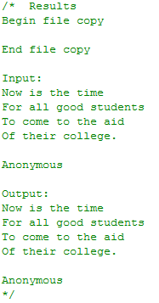
Copying Text File

Slide 26
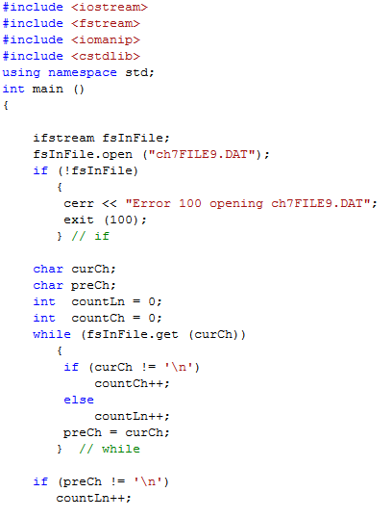
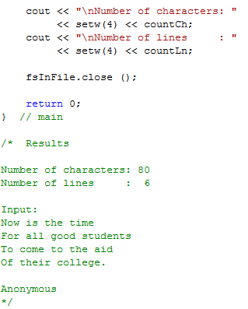
Counting Characters and Lines

Slide 27
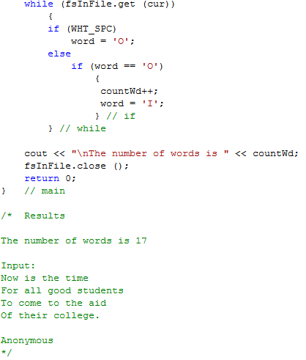
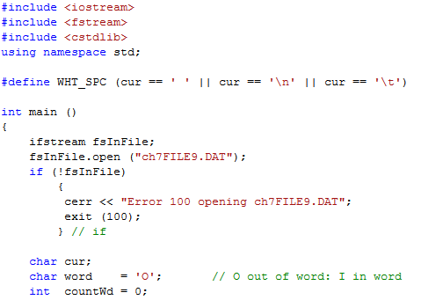
Counting Words

Slide 28
SOMETHING WORTH TO KNOW FROM C

Slide 29
What is “printf”?
cout << “I am “ << yourAge << “ years old” << endl;
printf(“I am %d years old\n”,yourAge);
http://www.codingunit.com/printf-format-specifiers-format-conversions-and-formatted-output
http://www.cplusplus.com/reference/clibrary/cstdio/printf/

Slide 30
scanf, fprintf, fscanf

Slide 31
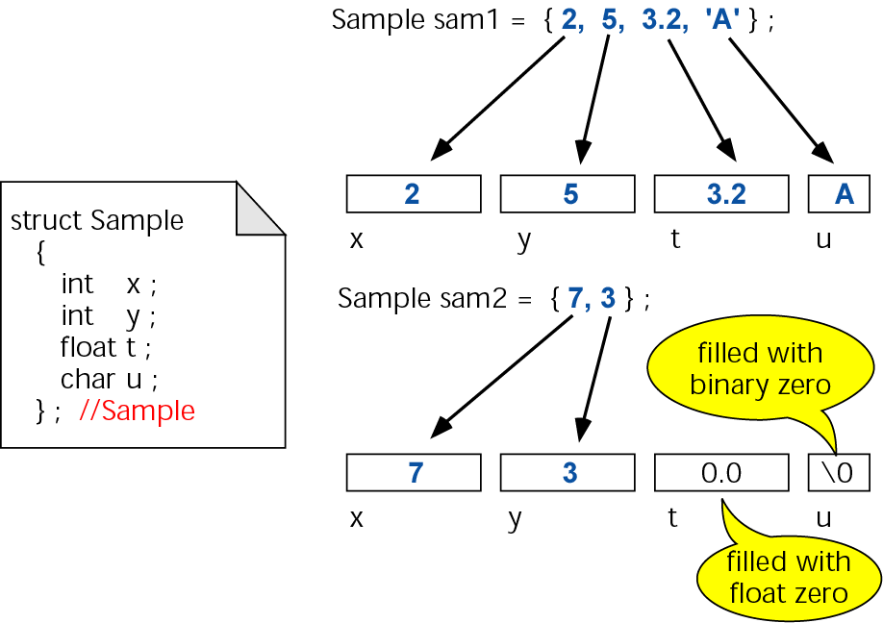
Structure Definition and Initialization

Slide 32
BITWISE OPERATORS

Slide 33
Appendix E. Bitwise Operators (1)
Bitwise “AND” operator (&)
  Forcing to zero
    To force a location to zero, use a zero bit
    To leave a location unchanged, use a one bit
First Operand Bit | Second Operand Bit | Result
0 | 0 | 0
0 | 1 | 0
1 | 0 | 0
1 | 1 | 1
Number xxxxxxxx &
Mask 00000111
--------
Result 00000xxx
The second operand in bitwise operators is called a mask

Slide 34
Appendix E. Bitwise Operators (2)
Bitwise “OR” operator (|)
  Forcing to one
    To force a location to one, use a one bit
    To leave a location unchanged, use a zero bit
First Operand Bit | Second Operand Bit | Result
0 | 0 | 0
0 | 1 | 1
1 | 0 | 1
1 | 1 | 1
Number xxxxxxxx |
Mask 11111000
--------
Result 11111xxx

Slide 35
Appendix E. Bitwise Operators (3)
Bitwise “Exclusive OR” operator (^)
  Forcing a change
    To force a location to change, use a one bit
    To leave a location unchanged, use a zero bit
One’s complement operator (~)
 | Second Operand Bit | Result
0 | 0 | 0
0 | 1 | 1
1 | 0 | 1
1 | 1 | 0
Number xxxxxxxx ^
Mask 11111000
--------
Result yyyyyxxx
Original Bit | Result
0 | 1
1 | 0

Slide 36
Appendix E. Bitwise Operators (4)
Shift operators (<<, >>)
Original 100…110001
Left shift (1) 00…1100010
Original 100…110001
Right shift (1) ?100…11000
Shift Value(m) | Multiplies by (2^{m}) | Shift Opreator
1 | 2 | <<1
2 | 4 | <<2
… | … | …
n | 2^{n} | <<n
Shift Value(m) | Divides by (2^{m}) | Shift Opreator
1 | 2 | >>1
2 | 4 | >>2
… | … | …
n | 2^{n} | >>n

